Slide 1
SmartMart
Online Supermarket System
Details:
Name: Pabbu Srivarsha
Ht.No:2303a51337
Department: Computer Science Academic Year: 2025 – 2026
Institution: SR UNIVERSITY

Slide 2
SmartMart
Online Supermarket System
Introduction
What is SmartMart?
Project Overview
🛒
📊
SmartMart is a feature-rich browser-based Online Supermarket System that simulates a real-world e-commerce grocery platform. It provides a seamless shopping experience for Customers and a powerful management dashboard for Staff and Admins — all in a single HTML/JS/CSS web application.
The system is AI-assisted: all source code was generated using AI tools (ChatGPT / Copilot) with targeted prompts, demonstrating AI-driven software development.
Customer Storefront
Admin Dashboard
🧾
⚑
Staff Order Manager
Smart Alerts Engine
📦
💰
Inventory Tracker
Profit & Loss View
SmartMart | Online Supermarket System
2 / 14

Slide 3
SmartMart
Online Supermarket System
Objectives
Goals we set out to achieve
01
Multi-Role Access
02
Full E-Commerce Flow
Separate login flows for Customer, Staff, and Admin with role-specific views and feature access control.
Product browsing, cart management, checkout with GST calculation, and order confirmation for customers.
03
Live Inventory Management
04
AI-Powered Alert Engine
55 real-world Indian grocery products tracked with stock levels, reorder points, and expiry dates.
Automated expiry and low-stock alerts categorised by severity (Critical, Warning, Info) for each role.
05
Analytics & Profit Reporting
06
AI-Assisted Development
Admin-only dashboards showing sales trends, category performance, P&L statements, and top products.
Entire codebase generated using AI prompting (ChatGPT / GitHub Copilot), showcasing modern AI dev workflows.
SmartMart | Online Supermarket System
3 / 14

Slide 4
SmartMart
Online Supermarket System
Stakeholders
Who uses SmartMart?
🛒
Customer
🧾
Staff
🔐
Admin
✔ Browses 55+ grocery products
✔ Views all incoming orders
✔ Full access to all sections
✔ Filters by category
✔ Updates order status
✔ Profit & Loss dashboard
✔ Adds items to cart
✔ Monitors expiry alerts
✔ Sales analytics & charts
✔ Checks out with GST billing
✔ Tracks low stock alerts
✔ Supplier management
✔ Tracks order history
✔ Manages inventory table
✔ All alerts + watch-level
SmartMart | Online Supermarket System
4 / 14

Slide 5
SmartMart
Online Supermarket System
Technologies Used
Programming Languages, Tools & Software
🌐
🎨
⚡
📊
HTML5
CSS3
JavaScript (ES6)
Chart.js 4.4
Semantic structure, multi-view SPA layout, modals, forms
Amazon-style navigation, card layouts, responsive grids
All app logic — login, cart, orders, charts, alerts
Bar, pie, line, doughnut charts for analytics & P&L
🤖
🧑‍💻
🌍
📁
ChatGPT / GPT-4
GitHub Copilot
VS Code
Browser (Chrome)
Primary AI tool used to generate all code via prompts
In-editor AI assist for code completion and refinement
Code editor used to organise and run the project locally
Runtime environment; no backend/server required
SmartMart | Online Supermarket System
5 / 14

Slide 6
SmartMart
Online Supermarket System
AI Prompts Used — Part 1
Prompts that generated the core codebase
P1
Login & Role System
"Build a login screen for a supermarket system. Users can enter their name, select a role (Customer, Staff, Admin) using clickable role cards, and enter any demo password. After login, show different screens based on role."
P2
Customer Storefront
"Create an Amazon-style customer shop with a top navbar (logo, search bar, cart button), category sub-nav, left sidebar category filter, and a product grid. Products should have name, price, rating, add-to-cart button."
P3
Cart & Checkout Modal
"Add a slide-in cart drawer showing selected items, quantity controls, subtotal, 5% GST, and grand total. Include a checkout modal that collects name, phone, address and places the order. Show order success with order ID."
P4
Admin Dashboard Overview
"Create an admin dashboard sidebar with sections: Overview, Alerts, Inventory, Orders, Profit & Loss, Analytics, Suppliers. The Overview should have metric cards (products, revenue, profit, low stock, expiry alerts)."
SmartMart | Online Supermarket System
6 / 14

Slide 7
SmartMart
Online Supermarket System
AI Prompts Used — Part 2
Prompts that generated advanced features
P5
Product Data Store
"Create a JavaScript data.js file with 55 real Indian supermarket products across 12 categories (Dairy, Fruits, Vegetables, Snacks, Beverages, Grains, Bakery, Oils, Personal Care, Frozen, Spices, Confectionery) with fields: id, name, cat, cost price, sell price, stock, sold, reorder level, expiry date, supplier, rating, reviews."
P6
Alert Engine
"Build an alerts engine that scans all products and generates alerts for: (1) expired items, (2) items expiring within 1–2 days (critical), (3) items expiring in 3–5 days (warning), (4) out-of-stock items, (5) critically low stock. Filter alerts by role — staff see expiry+stock, admin also see watch-level."
P7
Analytics & Charts
"Using Chart.js, add charts: weekly sales bar chart (revenue vs cost), category pie chart, inventory stock bar chart, hourly order volume, top 10 products bar chart, revenue by category doughnut chart, profit/loss 30-day line chart, and top margin products horizontal bar."
P8
Orders & Suppliers
"Create an orders management section where staff/admin can see all customer orders with status badges (Pending/Packed/Delivered), update status via dropdowns, and view order totals with GST. Also add a supplier directory table with 12 suppliers, their contact info, last order date, and status."
SmartMart | Online Supermarket System
7 / 14

Slide 8
SmartMart
Online Supermarket System
System Workflow
How SmartMart works end-to-end
🔐 User Login
👤 Customer Role
🧾 Staff Role
🔐 Admin Role
Browse Products
View Orders
Dashboard + Analytics
Add to Cart
Update Status
Profit & Loss
Checkout & Order
Monitor Alerts
Supplier Mgmt
SmartMart | Online Supermarket System
8 / 14

Slide 9
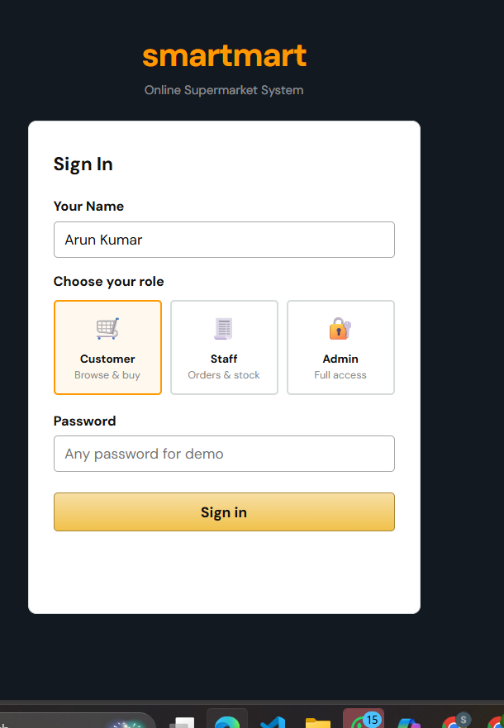
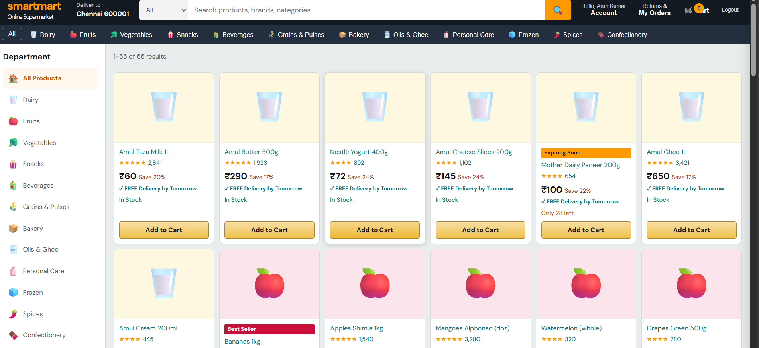
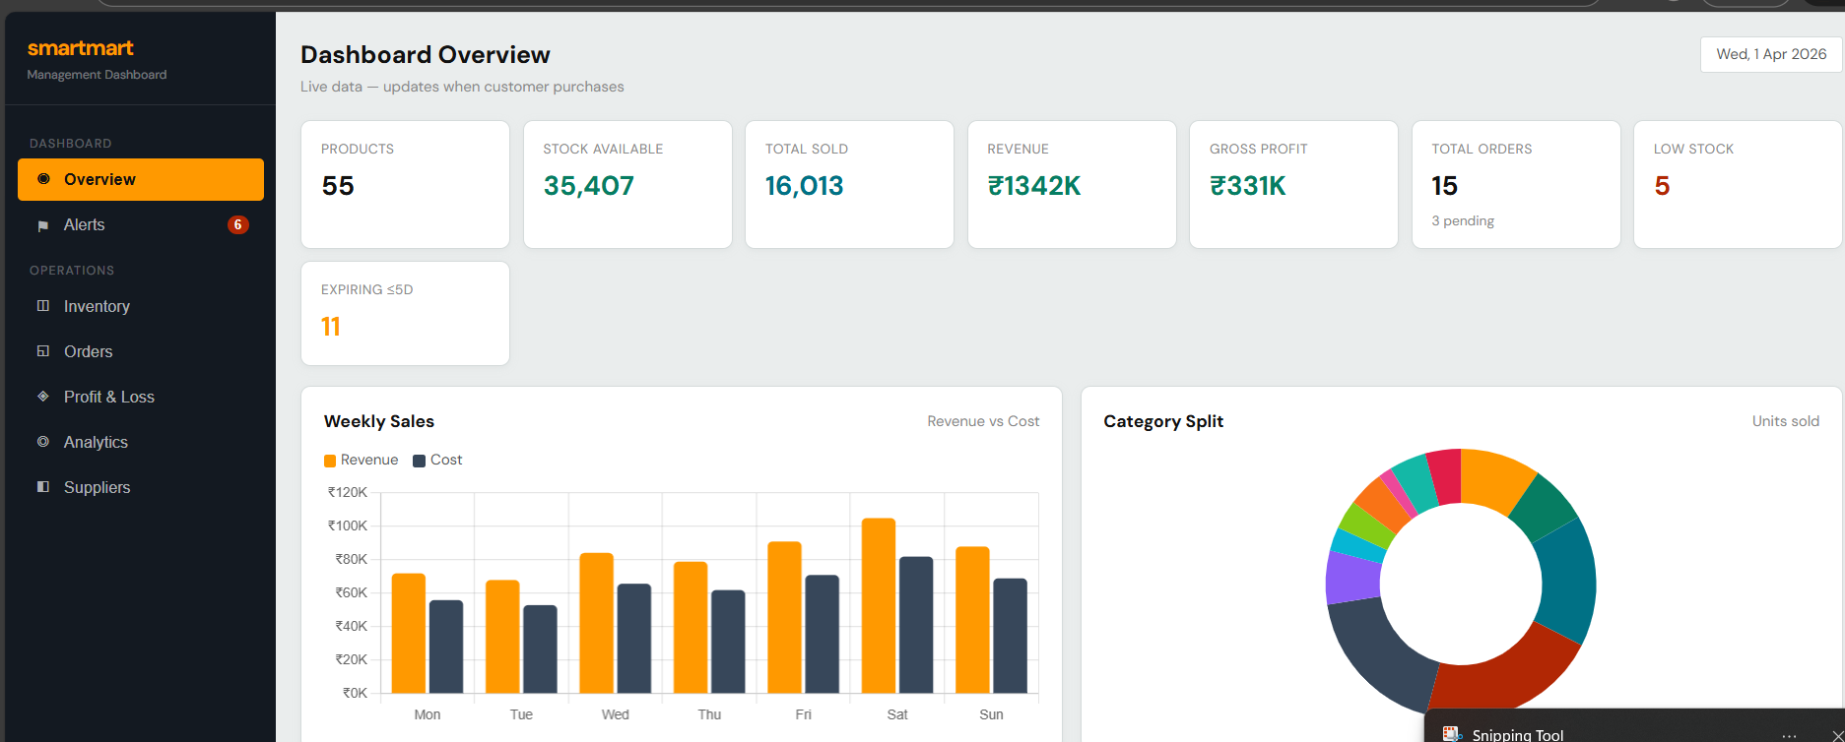
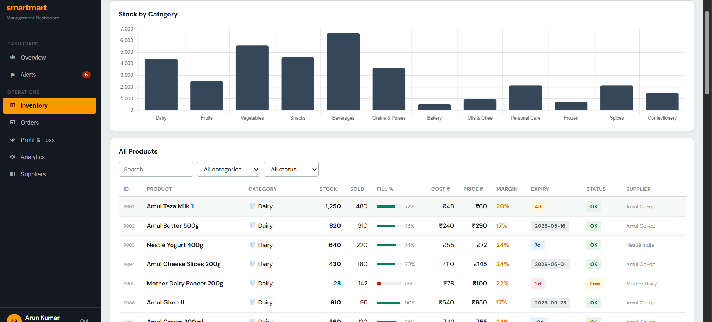
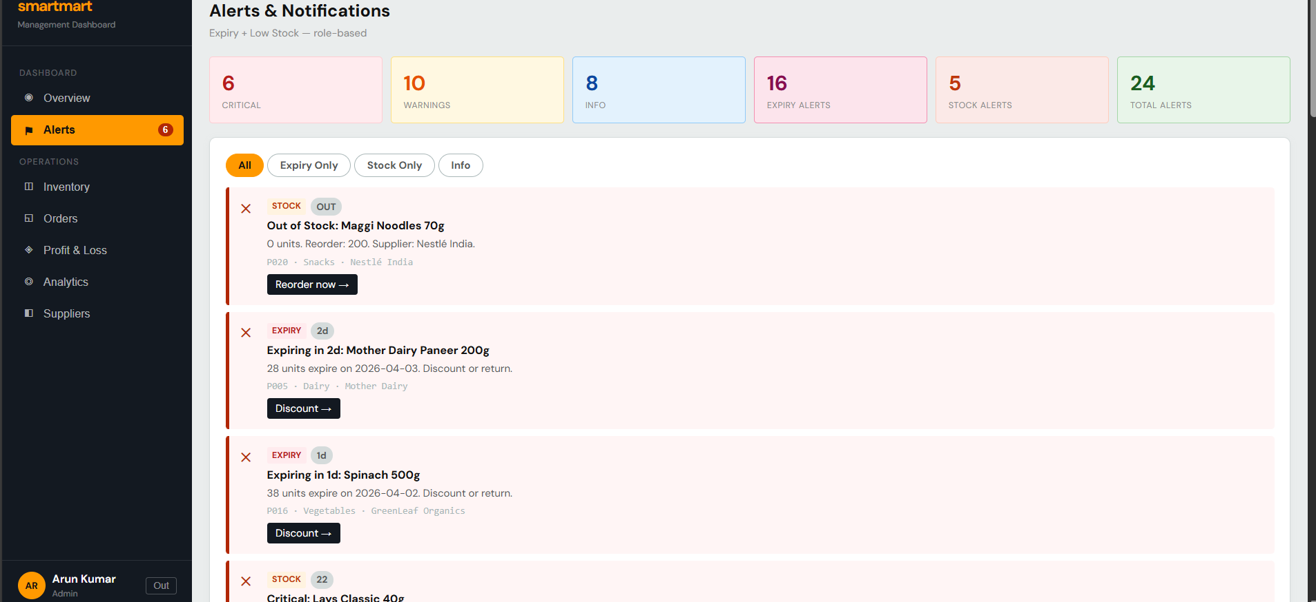
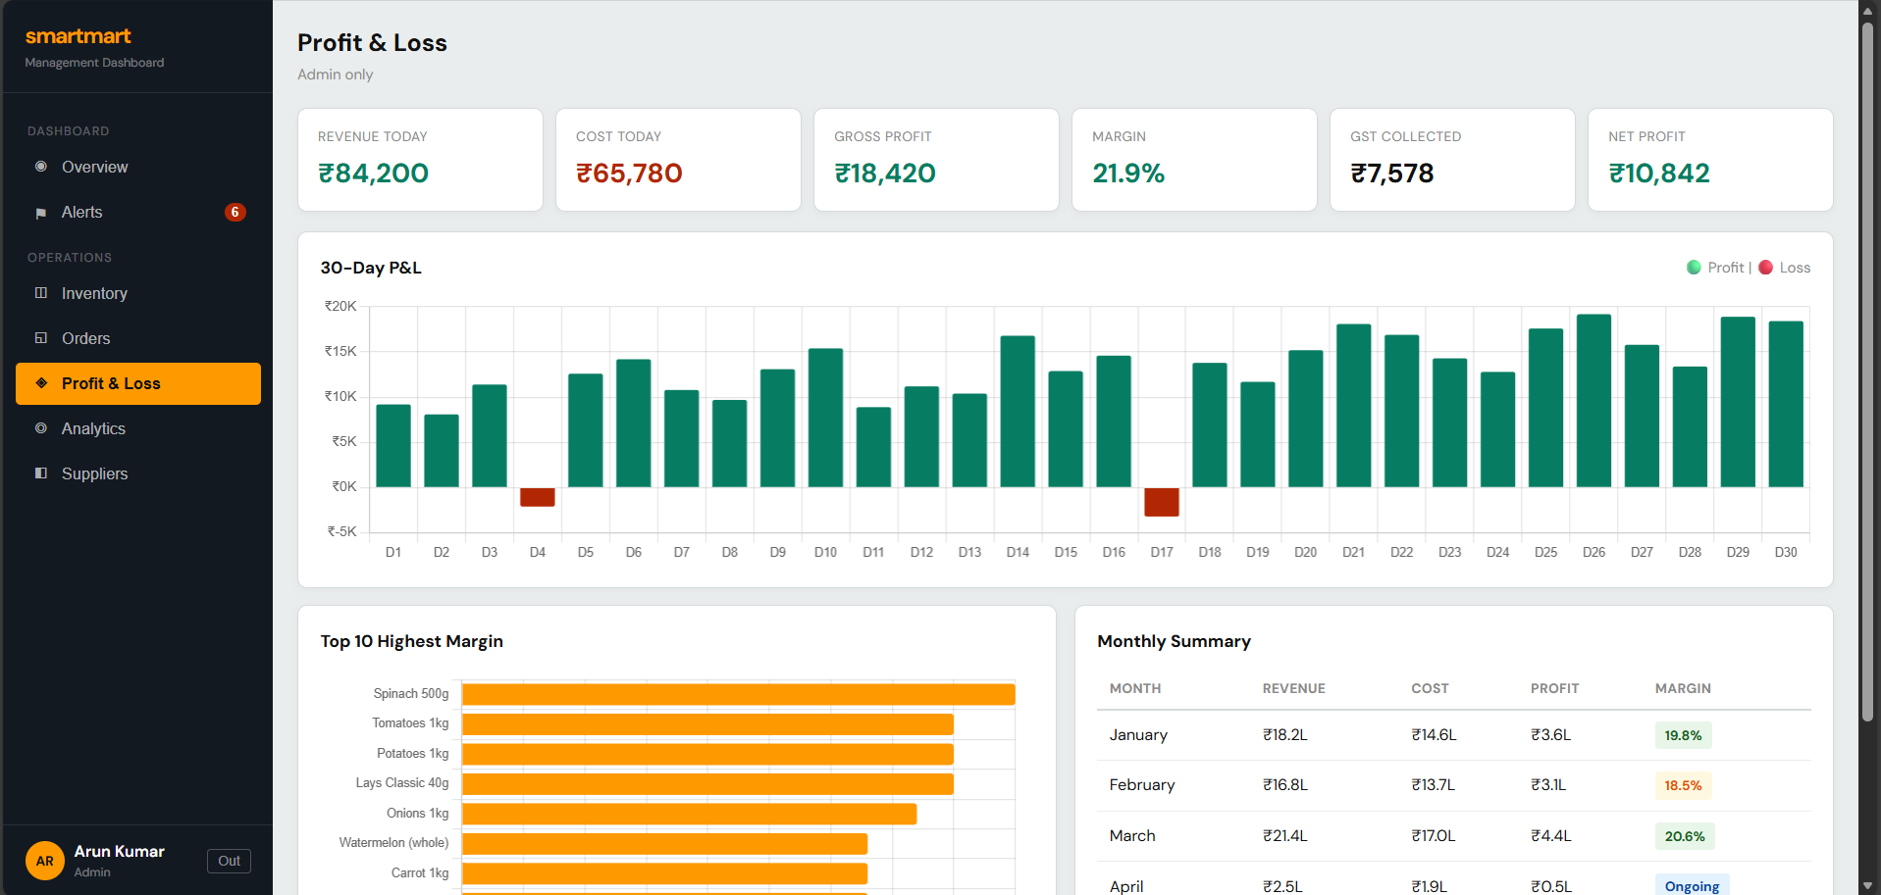
SmartMart
Online Supermarket System
Front-End Application View
Key screens of the SmartMart web application
[ Screenshot Area ]
[ Screenshot Area ]
[ Screenshot Area ]
Login Screen
Customer Store
Admin Dashboard
Role-based sign-in with Customer, Staff & Admin cards
Amazon-style product grid with search, categories & cart
Overview with KPI metric cards, weekly sales & category charts
[ Screenshot Area ]
[ Screenshot Area ]
[ Screenshot Area ]
Inventory Manager
Alert Engine
Orders & Profit View
55-product table with stock levels, expiry & supplier info
Role-filtered critical/warning/info alerts with action buttons
Customer order tracking + P&L, analytics charts for admin
SmartMart | Online Supermarket System
9 / 14

Slide 10
SmartMart
Online Supermarket System
AI Tools Used
Tools leveraged for this project
🤖
ChatGPT (GPT-4o)
All HTML structure, JavaScript logic, CSS styling, and data files were written via detailed prompts to ChatGPT. Each feature (login, cart, alerts, charts) was built prompt-by-prompt.
Primary Code Generator
🧑‍💻
GitHub Copilot
Used inside VS Code for inline code suggestions, function completions, and debugging help while organising and refining the AI-generated code.
In-Editor AI Assistant
📐
Claude / Gemini
Used for planning the system architecture, deciding which features to include for each role, and generating the product dataset structure.
Research & Ideation
SmartMart | Online Supermarket System
12 / 14

Slide 11
SmartMart
Online Supermarket System
References
Sources and tools used in this project
[1] OpenAI ChatGPT — chat.openai.com — Used for AI-assisted code generation
[2] GitHub Copilot — github.com/features/copilot — In-editor AI code completion
[3] Chart.js Documentation — chartjs.org — Bar, line, pie & doughnut chart library
[4] MDN Web Docs — developer.mozilla.org — HTML5, CSS3, JavaScript ES6 reference
[5] Amazon Design System — amazon.in — UI/UX inspiration for the customer storefront layout
[6] GST India — gst.gov.in — Goods and Services Tax rate reference for billing module
[7] Statista / NielsenIQ — Market data reference for Indian supermarket product pricing
[8] VS Code — code.visualstudio.com — Code editor used for development
SmartMart | Online Supermarket System
14 / 14

